Slide 1
EMC with Fermi Degeneracy
Progress Report
2023/12/20
B4 Kubo Keito

Slide 2
Background
The development of integrated circuits that can operate in a cryogenic environment of about the temperature of helium is an important issue for the realization of quantum computers.
At low temperatures, Pauli exclusion principle plays an important role.
Goal :
Create a Monte Carlo program for a two-dimensional electron gas that takes Fermi degeneracy into account.
Notes:
・量子コンピュータの実現のために、フェルミ縮退を考慮した2次元電子ガスのモンテカルロ・プログラムを作成することが目的

Slide 3
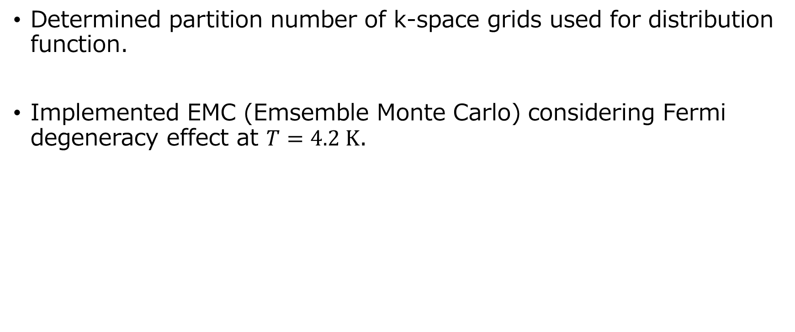
Progress
Determined partition number of k-space grids used for distribution function.
Implemented EMC (Emsemble Monte Carlo) considering Fermi degeneracy effect at $T=4.2 K$.

Slide 4
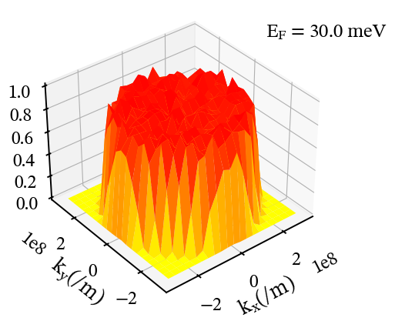
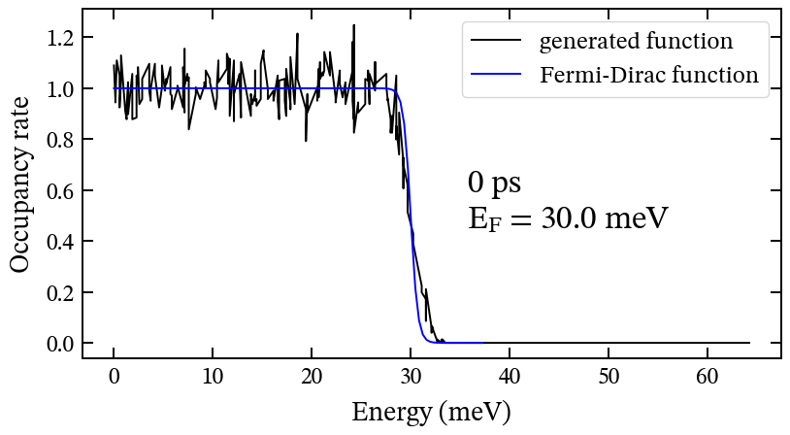

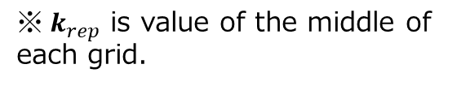
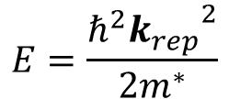
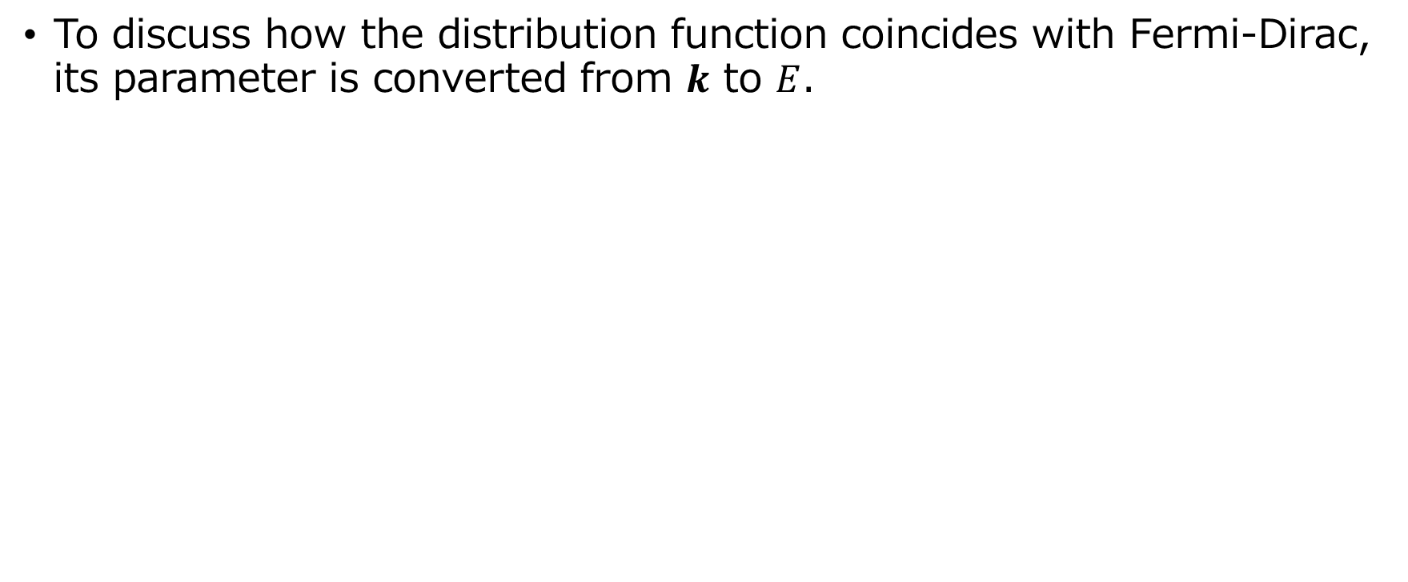
Distribution function
To discuss how the distribution function coincides with Fermi-Dirac, its parameter is converted from $k$ to $E$.
Generated distribution function will be called $f(E)$
$$E=\frac{ℏ^{2}{k_{rep}}^{2}}{2m^{∗}}$$
$※{ k}_{rep}$ is value of the middle of each grid.

Slide 5
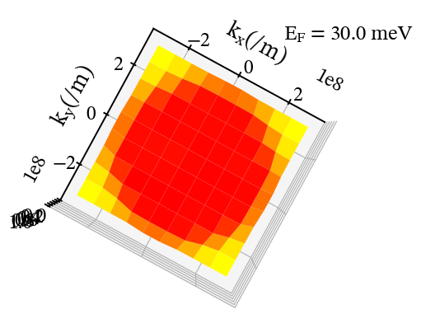
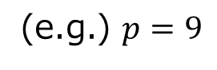
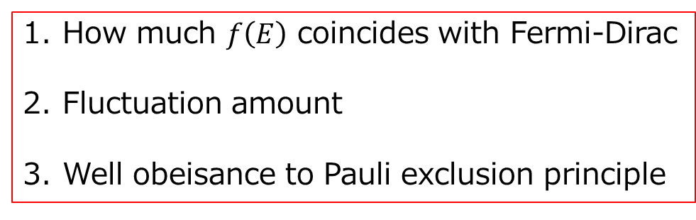
Find the best partition number
To find a suitable partition number(defined as $p$), I conducted EMC at $F=0$for various $p$
※Number of electrons is set ${10}^{5}$ consistently.
Checklist
How much $f\left(E\right)$ coincides with Fermi-Dirac
Fluctuation amount
Well obeisance to Pauli exclusion principle
(e.g.) $p=9$

Slide 6
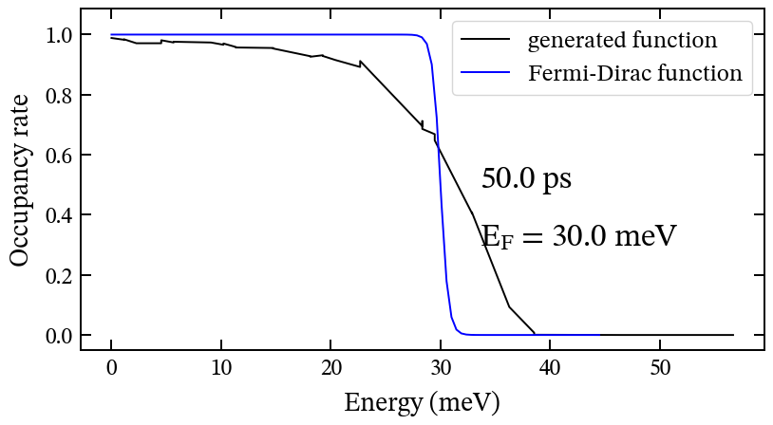
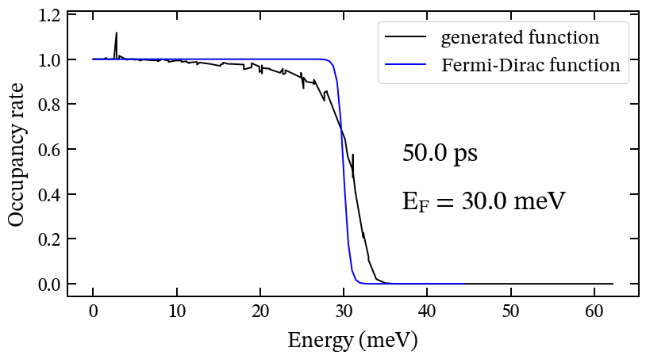
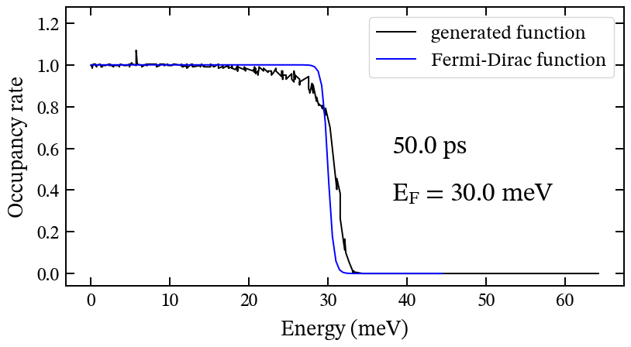
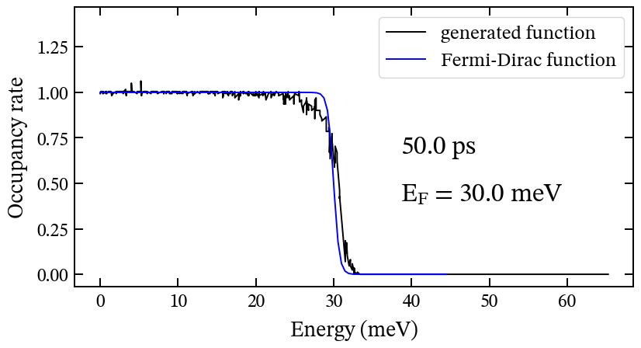
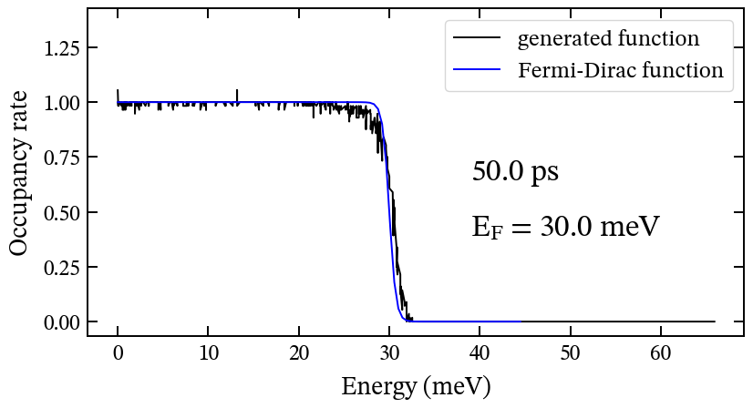
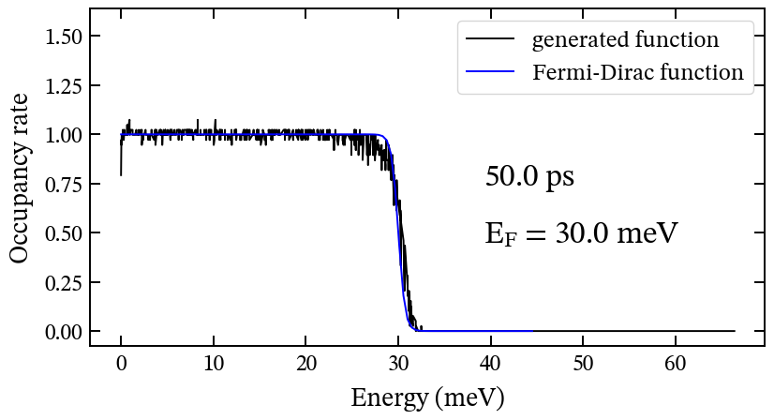
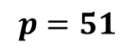
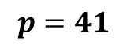
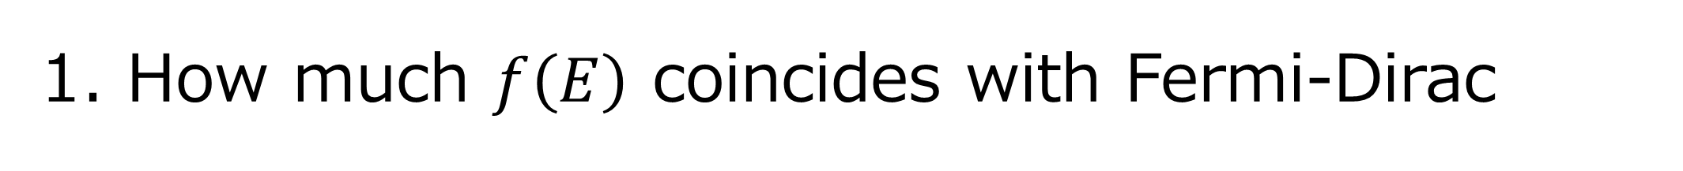
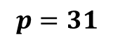
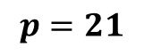
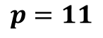
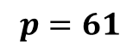
1. How much $f\left(E\right)$ coincides with Fermi-Dirac
$$p=11$$
$$p=21$$
$$p=31$$
Much Far
Far
Coinciding
$$p=41$$
$$p=51$$
$$p=61$$
Coinciding
Well Coinciding
Well Coinciding

Slide 7
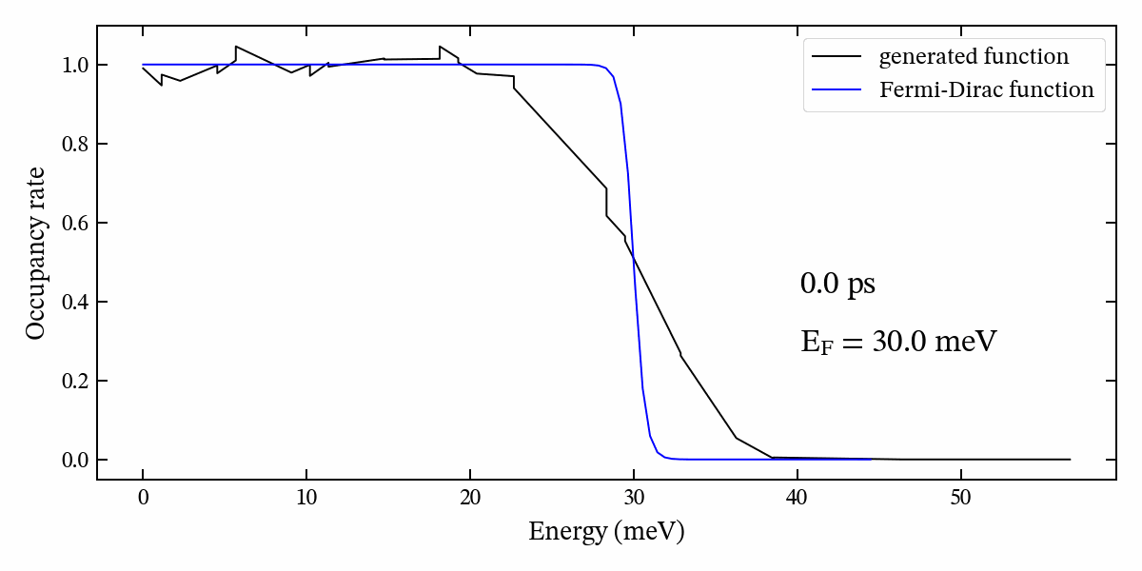
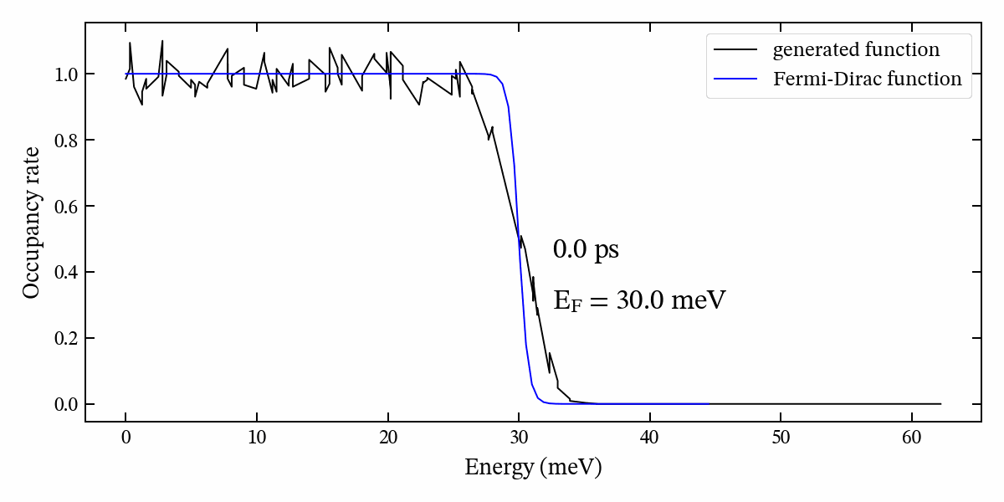
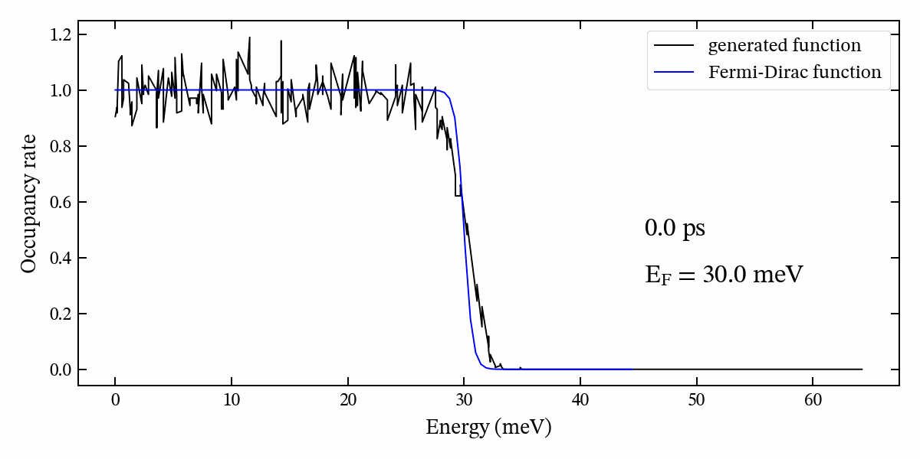
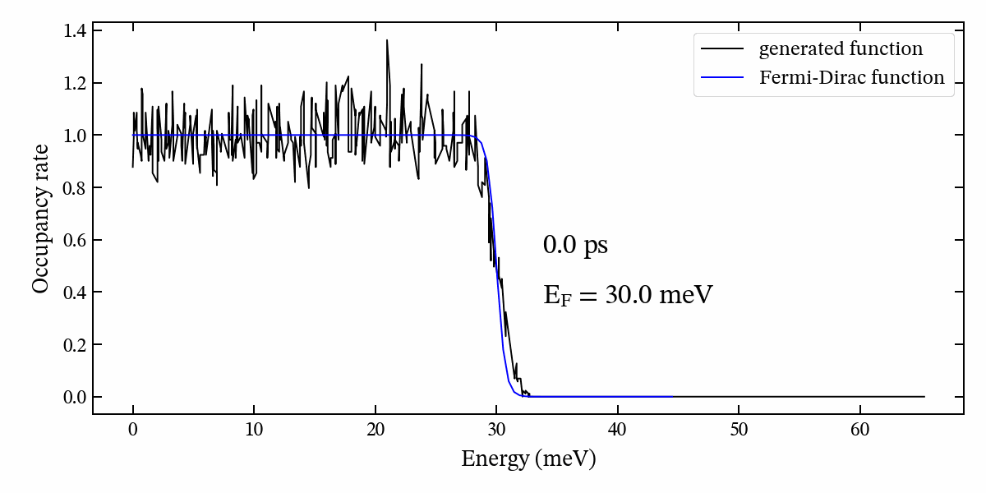
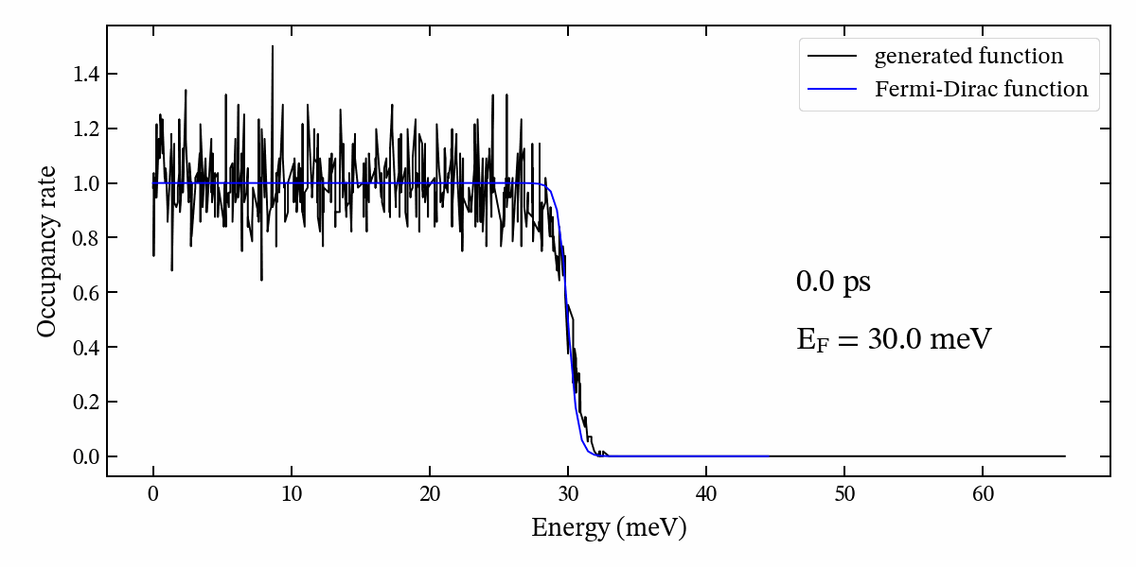
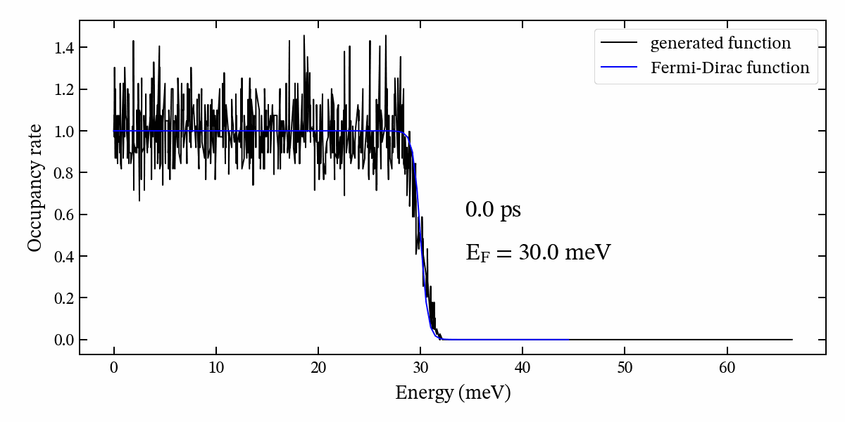
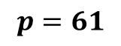
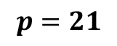
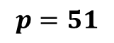
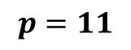
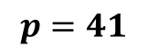
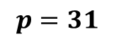
2. Fluctuation amount
Measured fluctuation amount, $f_{max}−f_{min}$, at $E=E_{F}$ for each partition.
$$p=11$$
$$p=21$$
$$p=31$$
0.07
0.12
0.16
$$p=41$$
$$p=51$$
$$p=61$$
0.27
0.36
0.38

Slide 8
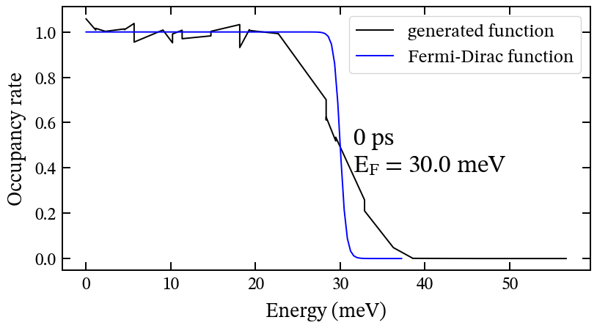
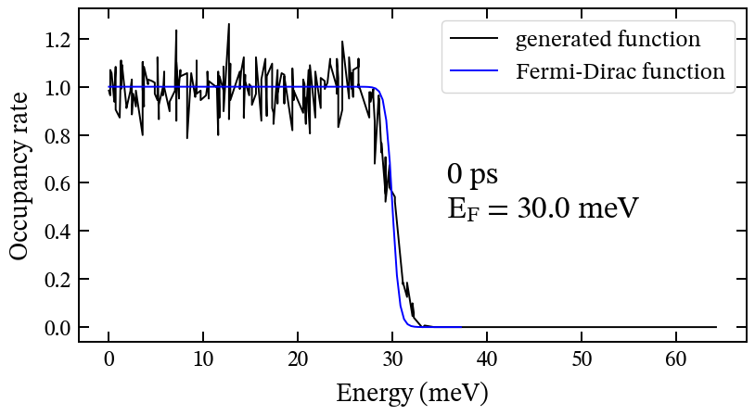
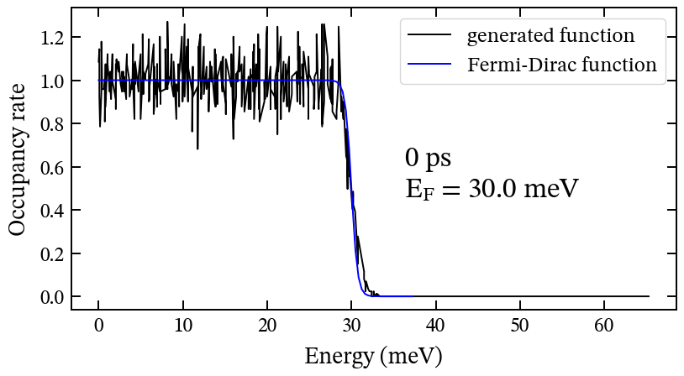
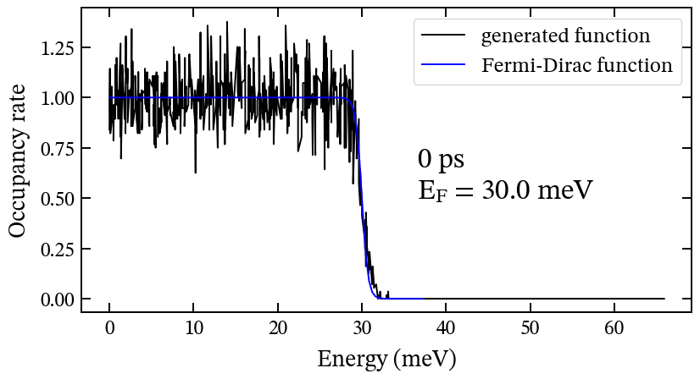
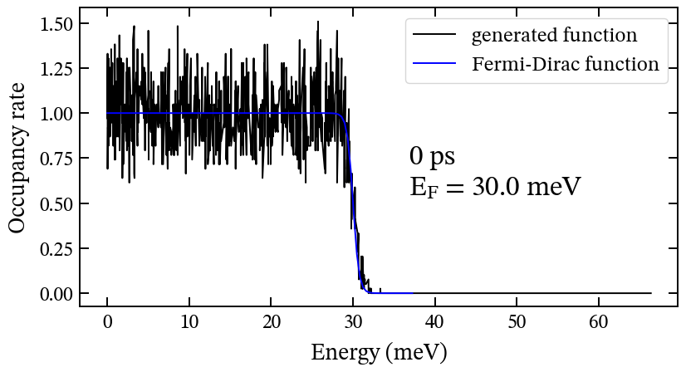
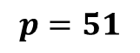
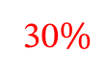
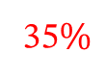
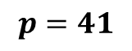
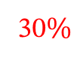
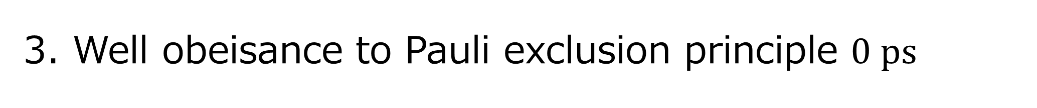
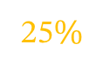
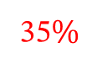
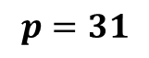
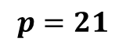

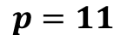

3. Well obeisance to Pauli exclusion principle $0 ps$
Measured number of cells where $f_{FD}\left(E\right)>0.8$ and $f\left(E\right)>1$ at $0 ps$, and the most exceeded value.
$$p=11$$
$$p=21$$
$$p=31$$
25$\%$
30$\%$
30$\%$
1.1
1.2
1.2
$$p=41$$
$$p=51$$
$$p=61$$
35$\%$
35$\%$
35$\%$
1.25
1.3
1.5

Slide 9



Why is $0 ps$ distribution so mess?
The initial distribution is determined by rejection sampling.
There is no Fermi degeneracy effect consideration in rejection sampling.
The distribution as average follows Fermi-Dirac, but many cells exceed 1 because of no restriction.
I’m suspicious about using this as the initial distribution.

Slide 10


















3. Well obeisance to Pauli exclusion principle $50 ps$
Conducted EMC with $F=0$ for $50 ps$, then measured
$$p=11$$
$$p=21$$
$$p=31$$
0$\%$
0.6$\%$
15$\%$
1.15
1.1
$$0.01$$
$$0.004$$
$$p=41$$
$$p=51$$
$$p=61$$
15$\%$
24$\%$
41$\%$
1.05
1.05
1.05
$$0.005$$
$$0.002$$
$$0.001$$

Slide 11

Checklist table
Because of 0 ps distribution, no partition seems suitable for EMC at $F>0$...
$$p$$ |  |  | 11 | 21 | 31 | 41 | 51 | 61
Coincidering with FD |  |  | Much far | far | coincidering | coincidering | Well coincidering | Well coincidering
Fluctuation amount |  |  | $$0.07$$ | $$0.12$$ | $$0.16$$ | $$0.27$$ | $$0.36$$ | $$0.38$$
Pauli exclusion principle violation | $$0 ps$$ | percent | $$25$$ | $$30$$ | $$30$$ | $$35$$ | $$35$$ | $$35$$
 |  | range | $$1.1$$ | $$1.2$$ | $$1.2$$ | $$1.25$$ | $$1.3$$ | $$1.5$$
 | $$50 ps$$ | percent | $$0$$ | $$0.6$$ | $$15$$ | $$15$$ | $$24$$ | $$41$$
 |  | range |  | $$1.15$$ | $$1.1$$ | $$1.05$$ | $$1.05$$ | $$1.05$$
 |  | average |  | $$0.01$$ | $$0.004$$ | $$0.005$$ | $$0.002$$ | $$0.001$$

Slide 12







Solution: Adopt $50 ps$distribution as initial one
enough Fermi degeneracy consideration
Adopt $50 ps$distribution as initial one
EMC at $F>0$
EMC at $F>0$
Not enough Fermi degeneracy consideration
EMC at $F=0$ for $50 ps$
EMC at $F>0$

Slide 13




(Ref) EMC at $F=0$ for $50 ps$
$$Rejection sampling cut off$$
$$energy causes this error.$$
$$Theorerical value calculated by$$
$$Fermi integration$$

Slide 14


Checklist table (revised)
$p=31$ might be suitable for distribution function when $N_{MC}={10}^{5}$
$$p$$ |  |  | 11 | 21 | 31 | 41 | 51 | 61
Coincidering with FD |  |  | Much far | far | coincidering | coincidering | Well coincidering | Well coincidering
Fluctuation amount |  |  | $$0.07$$ | $$0.12$$ | $$0.16$$ | $$0.27$$ | $$0.36$$ | $$0.38$$
Pauli exclusion principle violation | $$50 ps$$ | percent | $$0$$ | $$0.6$$ | $$15$$ | $$15$$ | $$24$$ | $$41$$
 |  | range |  | $$1.15$$ | $$1.1$$ | $$1.05$$ | $$1.05$$ | $$1.05$$
 |  | average |  | $$0.01$$ | $$0.004$$ | $$0.005$$ | $$0.002$$ | $$0.001$$

Slide 15







Solution2: Apply Pauli rule for initialization
[current]
$$p=21$$
$$p=31$$
$$p=41$$
[new]
(Pros)
$f(E)$ never exceeds $1$.
Not fluctuating so much.
(Cons)
Need to amplify k-space grid size.
Can’t prove this is correct for now.

Slide 16
Solution2: P

Slide 17


Start-up response : Problem fixed
At previous EMC, a slight decrease in mean energy is observed for a short period of time after start-up
→ Fixed
Previous EMC
EMC with Fermi degeneracy

Slide 18



EMC at $E_{F}=10 meV$
Convergence value:
$$29.5 meV$$

Slide 19



EMC at $E_{F}=20 meV$
Convergence value:
$$23.5 meV$$

Slide 20



EMC at $E_{F}=30 meV$
Convergence value:
$$27.5 meV$$

Slide 21



EMC at $E_{F}=50 meV$
Convergence value:
$$33.1 meV$$

Slide 22

Near future plan
Implement realistic scattering by making it related to $E$
Write a thesis

